Slide 1
Dependable Distributed Systems
Master of Science in Engineering in Computer Science
AA 2026/2027
Lecture 8: Broadcast Communications

Slide 2
Recap: what we know up to now
Define a system model and specify a problem or an abstraction in terms of safety and liveness
point-to-point communication abstractions
  fair-loss, stubborn or perfect links
how to timestamp events
  physical clocks
  logical clocks
handling failures
  Failure Detector
  Leader Election
Up to now, the focus has been on the interaction between two processes (like in a client/server environment)

Slide 3
Communication in a group: Broadcast
?
No Failures
Crash Failures

Slide 4
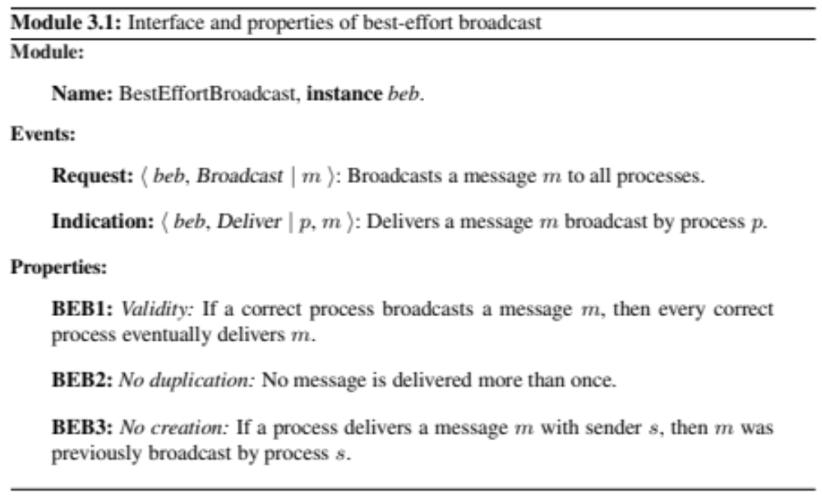
Best Effort Broadcast (BEB)
Specification
Broadcast (msg)
Deliver(msg)
BEB

Slide 5
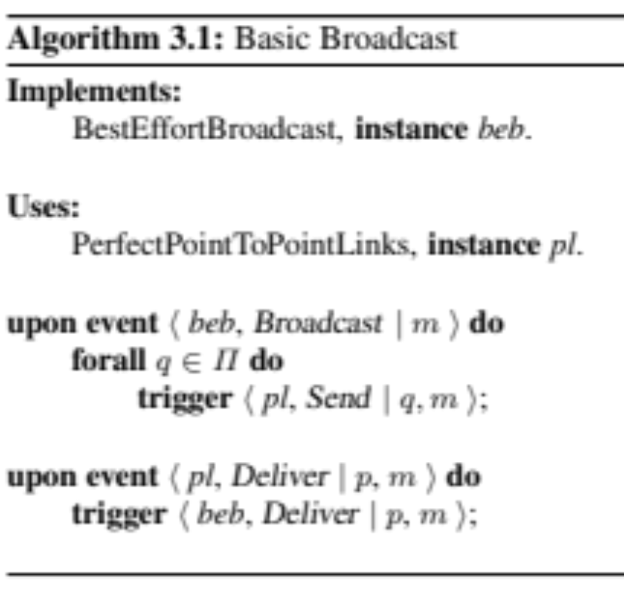
Best Effort Broadcast (BEB)
Implementation
System model
Asynchronous system
perfect links
crash failures
BEB_Broadcast (m)
BEB_Deliver(m)
BEB
pp2pSend (m)
pp2pDeliver(m)
Perfect Point-to-point Link

Slide 6
Correctness
Validity
  It comes from the reliable delivery property of perfect links + the fact that the sender sends the message to every other process in the system.
No Duplication
  it directly follows from the No Duplication of perfect links + assumption on the uniqueness of messages (i.e., different messages have different identifiers).
No Creation
  it directly follows from the corresponding property of perfect links.

Slide 7
Observations on Best Effort Broadcast (BEB)
m₁
m₂
m₁
m₂
m₁
m₁
m₁
m₂
m₂
BEB ensures the delivery of messages as long as the sender does not fail
If the sender fails processes may disagree on whether or not deliver the message

Slide 8
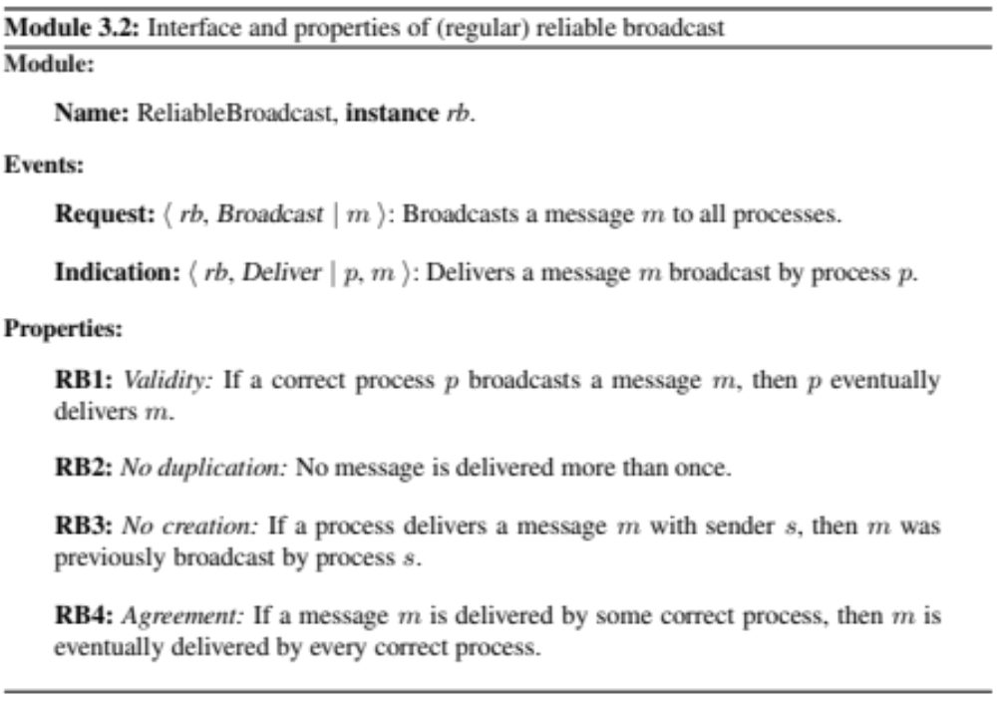
(Regular) Reliable Broadcast (RB)
RB_Broadcast (msg)
RB_Deliver(msg)
RB
Same as BEB
Liveness: agreement

Slide 9
BEB vs RB
p1
Satisfies BEB but not RB
(violation of the Agreement Property)
p2
p3
p1
Satisfies RB
p2
Broadcast Event
Deliver Event
p3

Slide 10
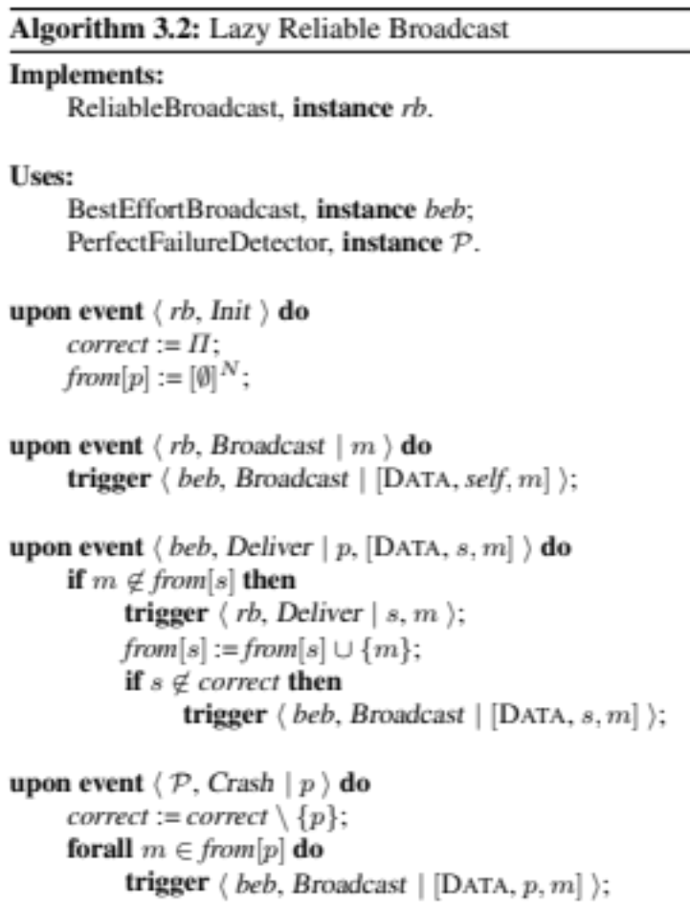
(Regular) Reliable Broadcast (RB)
Implementation in Synchronous Systems
RB_Broadcast (m)
RB_Deliver(m)
RB
BEB_Broadcast (m)
BEB_Deliver(m)
Crash (p_{i})
BEB
Perfect FD
P
The algorithm is Lazy in the sense that it retransmits only when necessary

Slide 11
Example
m1
m2
p₁
m1
m1
m2
p₂
m1
m1
m2
crash(p1)
m1
p₃
m1
crash(p1)
m1
m2
BeB_Deliver
RB_Deliver
BeB_Broadcast
RB_Broadcast

Slide 12
Example
m1
m2
p₁
m1
m2
m1
p₂
m1
m2
m1
crash(p1)
m1
p₃
m1
crash(p1)
m1
BeB_Deliver
RB_Deliver
BeB_Broadcast
RB_Broadcast

Slide 13
Example
m1
m2
p₁
m1
m2
m1
p₂
m1
crash(p1)
m1
m1
m2
m1
p₃
m1
crash(p1)
m1
m1
m2
BeB_Deliver
RB_Deliver
BeB_Broadcast
RB_Broadcast

Slide 14
Example
m1
m2
p₁
m1
m1
m2
p₂
m1
crash(p1)
m1
m1
m2
m1
p₃
m1
crash(p1)
m1
m1
BeB_Deliver
RB_Deliver
BeB_Broadcast
RB_Broadcast

Slide 15
Example with removal of retransmission
m1
m2
p₁
m1
m2
m1
p₂
m1
crash(p1)
m1
m1
m2
m1
p₃
m1
crash(p1)
m1
m1
BeB_Deliver
RB_Deliver
BeB_Broadcast
RB_Broadcast

Slide 16
Performance of Lazy RB Algorithm
Best case
  1 BEB message per one RB message
Worst case
  n-1 BEB messages per one RB (this is the case with n-1 failures)
What if the FD is not perfect?

Slide 17
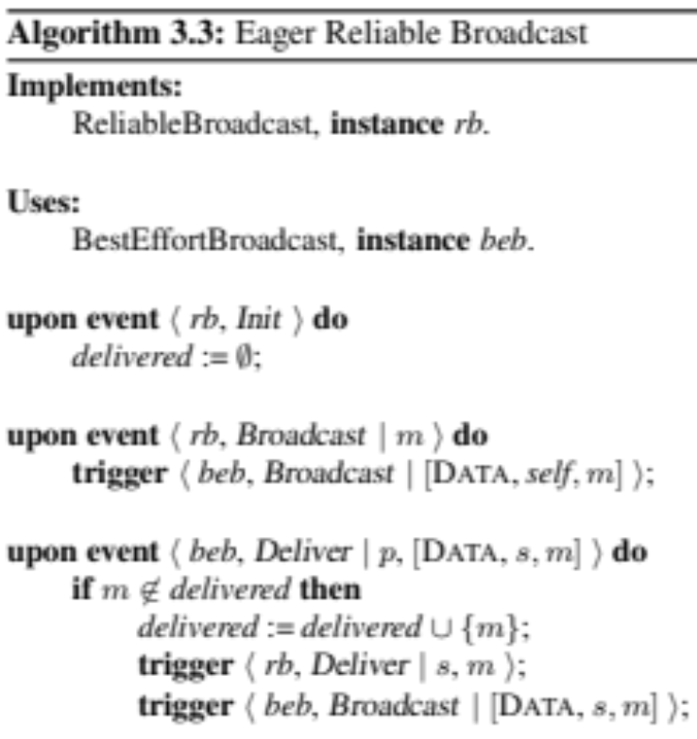
(Regular) Reliable Broadcast (RB)
Implementation in Asynchronous Systems
RB_Broadcast (m)
RB_Deliver(m)
RB
BEB_Broadcast (m)
BEB_Deliver(m)
BEB
The algorithm is Eager in the sense that it retransmits every message

Slide 18
Performance of Eager RB Algorithm
Best case = Worst case
  n BEB messages per one RB

Slide 19
BEB vs RB
p1
Satisfies BEB but not RB
(violation of the Agreement Property)
p2
p3
p1
Satisfies RB
p2
p3

Slide 20
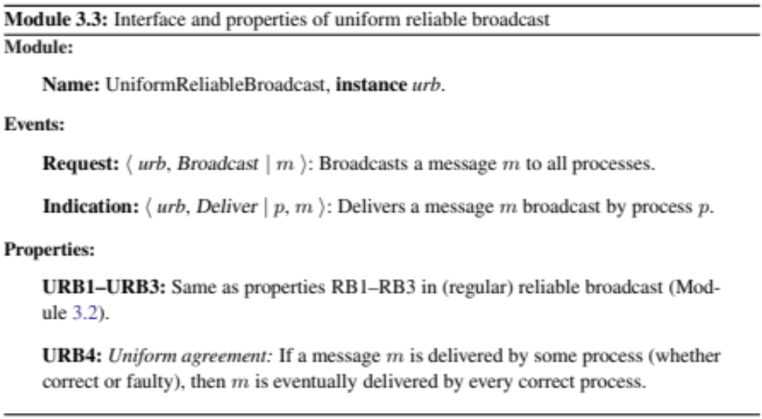
Uniform Reliable Broadcast (URB) Specification
URB_Broadcast (msg)
URB_Deliver(msg)
URB
Same as BEB and RB
Uniform agreement
Agreement on a message delivered by any process (crashed or not)!
the set of messages delivered by a correct process is a superset of the ones delivered by a faulty one

Slide 21
BEB vs RB vs URB
R1
R2
p1
p1
p2
p2
p3
p3
BEB if yellow message is sent by p1
Non-correct otherwise
URB

Slide 22
BEB vs RB vs URB
RB if yellow message is sent by p1
Non-correct otherwise
URB
R3
R4
p1
p1
p2
p2
p3
p3

Slide 23
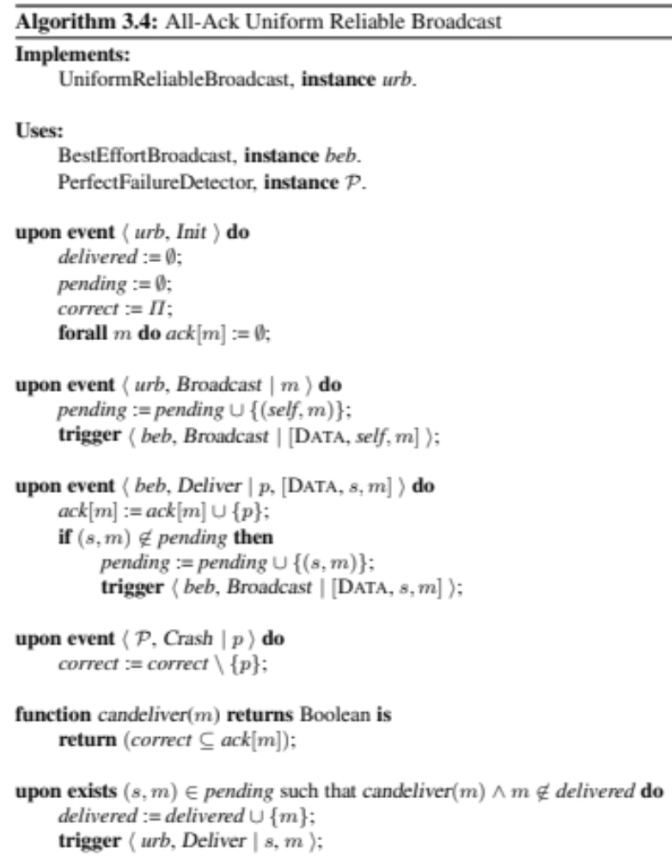
Uniform Reliable Broadcast (URB) Implementation in Synchronous System
URB_Broadcast (m)
URB_Deliver(m)
URB
BEB_Broadcast (m)
BEB_Deliver(m)
Crash (p_{i})
BEB
Perfect FD
P

Slide 24
Example
Delivered = empty
Pending = empty
Correct = {p1, p2, p3}
ack₁[m1]= {p3}
pending₁={<p3, m1>}
ack₁[m1]= {p3, p2}
ack₁[m1]= {p3, p2, p1}
p₁
m1
<P3, m1> from p2
<P3, m1> from p3
<P3, m1> from p1
m1
<P3, m1> from p3
ack₂[m1]= {p3, p2}
p₂
ack₂[m1]= {p3, p2, p1}
ack₂[m1]= {p3}
pending₂={<p3, m1>}
<P3, m1> from p2
<P3, m1> from p1
m1
ack₃[m1]= {p3}
ack₃[m1]= {p3, p2}
p₃
pending₃ = {<p3, m1>}
ack₃[m1]= {p3, p2, p1}
<P3, m1> from p3
<P3, m1> from p2
<P3, m1> from p1

Slide 25
Example
ack₁[m1]= {p3, p2}
pending₁={<p3, m1>}
ack₁[m1]= {p3, p2, p1}
pending₁={<p3, m1>}
Delivered = empty
Pending = empty
Correct = {p1, p2, p3}
ack₁[m1]= {p3}
pending₁={<p3, m1>}
p₁
m1
<P3, m1> from p3
<P3, m1> from p2
<P3, m1> from p1
m1
ack₂[m1]= {p3, p2}
pending₂={<p3, m1>}
correct₂={p₂, p₃}
p₂
ack₂[m1]= {p3}
pending₂={<p3, m1>}
<P3, m1> from p2
Crash(p1)
m1
p₃
pending₃ = {<p3, m1>}
<P3, m1> from p3
<P3, m1> from p2
Crash(p1)

Slide 26
Example
Delivered = empty
Pending = empty
Correct = {p1, p2, p3}
ack₁[m1]= {p2}
pending₁={<p3, m1>}
ack₁[m1]= {p2, p1}
pending₁={<p3, m1>}
correct₁={p₁, p₂}
p₁
m1
m1
m1
<P3, m1> from p2
<P3, m1> from p1
Crash(p3)
ack₂[m1]= {p3, p2, p1}
pending₂={<p3, m1>}
p₂
m1
m1
m1
m1
ack₂[m1]= {p3}
pending₂={<p3, m1>}
<P3, m1> from p2
<P3, m1> from p1
Crash(p3)
m1
ack₂[m1]= {p3, p2}
pending₂={<p3, m1>}
p₃
pending₃ = {<p3, m1>}

Slide 27
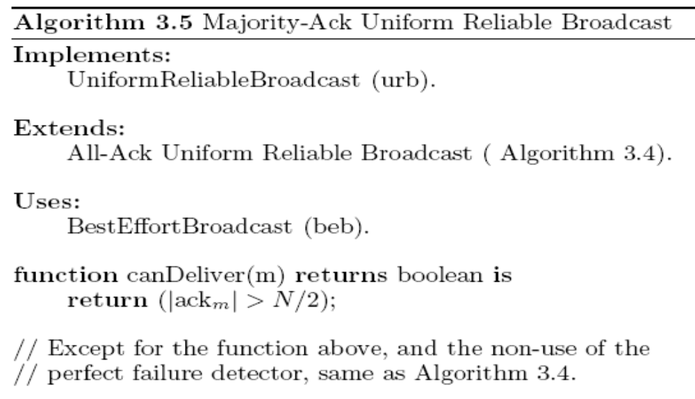
Uniform Reliable Broadcast (URB) Implementation in Asynchronous System
URB_Broadcast (m)
URB_Deliver(m)
URB
BEB_Broadcast (m)
BEB_Deliver(m)
BEB
!
We need to assume a majority of correct
processes

Slide 28
Uniform Reliable Broadcast
There exists an algorithm for synchronous system using Perfect failure detector
There exists an algorithm for asynchronous system when assuming a “majority of correct processes”
Can we devise a uniform reliable broadcast algorithm for a partially synchronous system (using an eventually perfect failure detector) but without the assumption of a majority of correct processes?

Slide 29
Probabilistic broadcast
Message delivered 99% of the times
Not fully reliable
Large & dynamic groups
Acks make reliable broadcast not scalable

Slide 30
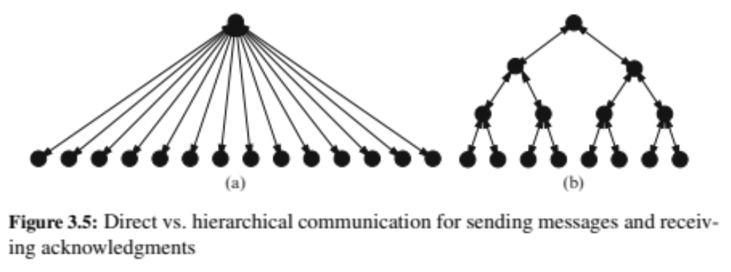
Ack Implosion and ack tree
Problems:
Process spends all its time by doing the ack task
Maintaining the tree structure

Slide 31
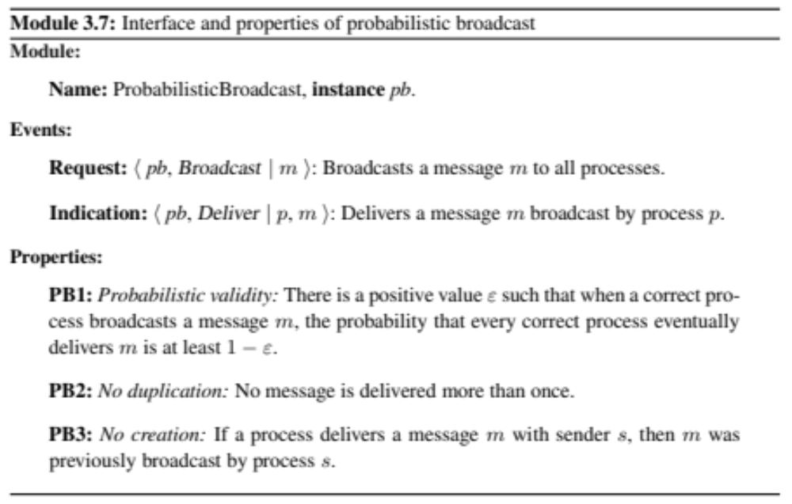
Probabilistic Broadcast
Pb_Broadcast (msg)
Pb_Deliver(msg)
PbB

Slide 32
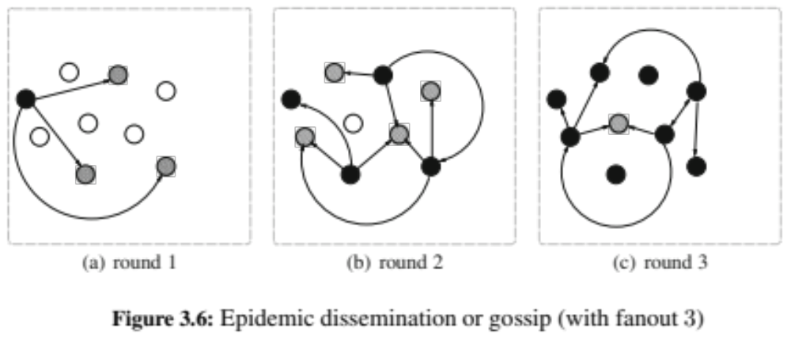
Gossip Dissemination
A process sends a message to a set of randomly chosen k processes
A process receiving a message for the first time forwards it to a set of k randomly chosen processes (this operation is also called a round)
The algorithm performs a maximum number of r rounds

Slide 33
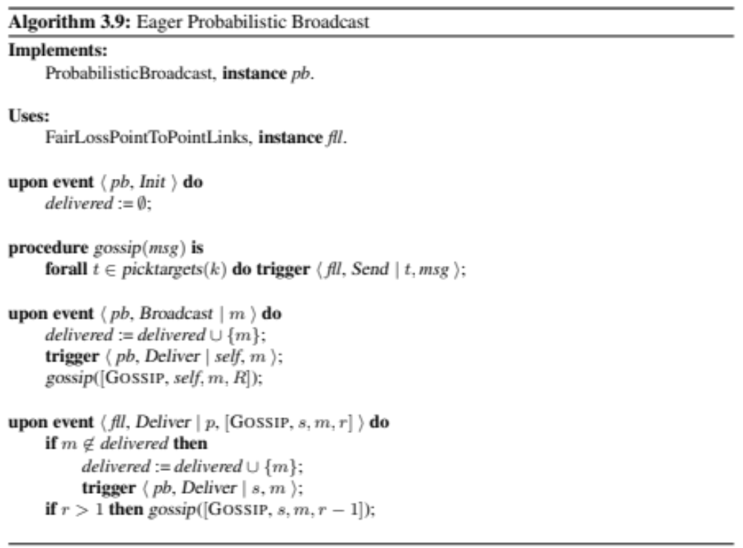
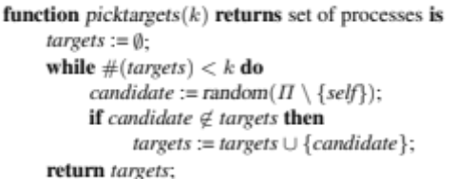
Eager Probabilistic Broadcast

Slide 34
References
C. Cachin, R. Guerraoui and L. Rodrigues. Introduction to Reliable and Secure Distributed Programming, Springer, 2011
  Chapter 3 - from Section 3.9 (except 3.9.6)
  Chapter 6 – Section 6.1

